Slide 1
ADVANCED SCIENTIFIC CALCULATOR
Technologies Used: Python | Tkinter | NumPy | Matplotlib
Presented By:
Neelam S Upadhyay

Slide 2
Introduction
The Advanced Scientific Calculator is a Python-based desktop application developed using Tkinter.
The application provides a modern graphical interface and combines several types of calculations in one application.
Main modes
Basic Calculator
Scientific Calculator
Statistics Mode
Programmer Mode
Graph Plotting Mode

Slide 3
Objectives
Develop a functional desktop calculator using Python.
Create a user-friendly graphical interface.
Implement scientific mathematical operations.
Add statistical calculations.
Add programmer-oriented calculations.
Add mathematical graph plotting.
Implement memory and calculation history.
Support keyboard interaction.
Provide Light and Dark themes.
Develop a modular and maintainable project.

Slide 4
Technologies & Tools
Technology | Purpose
Python | Main Programming Language
Tkinter | Graphical User Interface
Math | Scientific calculations
Statistics | Statistical Calculations
Numpy | Numerical Processing
Matplotlib | Graph Plotting
VS Code | Development enviornment

Slide 5
Main Features
Scientific Calculator
Arithmetic operations
Trigonometric functions
Logarithms
Square root
Factorial
Powers
DEG/RAD modes
Statistics
Mean
Median
Mode
Range
Population variance
Population standard deviation

Slide 6
Cont…..
Programmer Mode
Decimal
Binary
Octal
Hexadecimal
Bitwise operations
Shift operations
Graph Plotting
Mathematical functions
Custom X/Y ranges
Multiple functions
Grid
Reset and Clear

Slide 7
User Interface Graphical User Interface
The application provides:
Modern calculator layout
Expression display
Calculation history
Memory controls
Status messages
Keyboard support
Light/Dark theme
Separate windows for advanced features

Slide 8
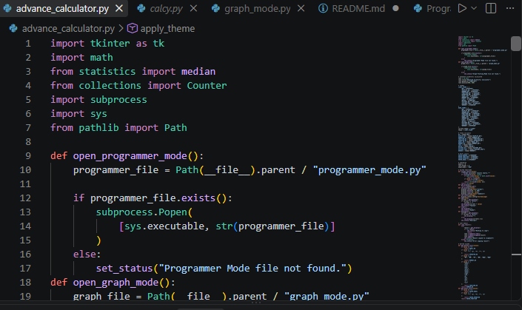

Slide 9
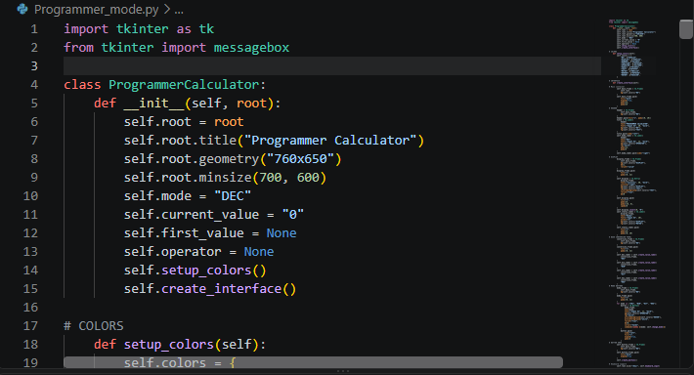
Programmer Mode
Programmer Mode provides number-system and bitwise operations.
Decimal:255
Binary:11111111
Octal:377
Hexadecimal: FF
It also supports operations such as:
AND
OR
XOR
NOT
Left Shift
Right Shift

Slide 10
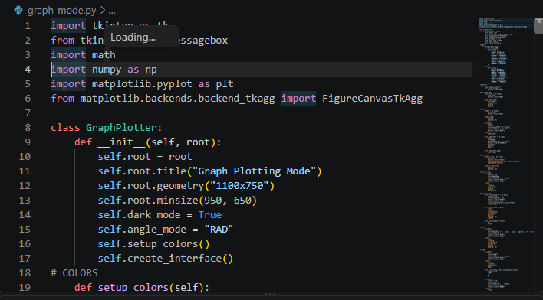
Graph Plotting Mode
The graphing module uses NumPy and Matplotlib.
Users can enter mathematical functions such as:
x^2 sin(x) cos(x) x^3 + 2*x sqrt(x)
The module provides:
X range
Y range
Plot
Clear
Reset
Grid
DEG/RAD mode
Multiple functions on one graph

Slide 11
Project Structure
Project3.Calculator/
├── Advance_Calculator.py
├── calcy.py
├── programmer_mode.py
├── graph_mode.py
├── demo.ipynb
├── demo.txt
└── README.md

Slide 12
Cont….
Module Responsibilities
Advance_Calculator.py Main Advanced Scientific Calculator
calcy.py Basic Calculator / launcher
programmer_mode.py Programmer calculations
graph_mode.py Graph plotting functionality
README.md Project documentation

Slide 13
Testing
Calculator Testing
Addition
Subtraction
Multiplication
Division
Scientific functions
Memory operations
History
Graph Testing
x²
sin(x)
cos(x)
Multiple functions
Custom graph ranges
Statistics Testing
Mean
Median
Mode
Variance
Standard deviation
Programmer Testing
Number conversions
Bitwise operations
Shift operations
Result: All implemented features were tested successfully.

Slide 14
Future Scope
Possible future improvements include:
Matrix calculations
Complex-number calculations
Equation solving
Derivatives and integration
Advanced graph analysis
Graph export
Calculation history export
Unit conversion
More programmer functions
Additional themes
Improved keyboard shortcuts

Slide 15
Conclusion
The Advanced Scientific Calculator demonstrates the practical use of Python for developing a complete desktop application.
The project combines:
Python + Tkinter + NumPy + Matplotlib into a single application that provides:
Scientific calculations
Statistical analysis
Programmer calculations
Graph visualization
Memory and history
Modern GUI features
The project also provided practical experience in GUI development, modular programming, mathematical computation, external libraries, testing, and project documentation.

